Slide 1

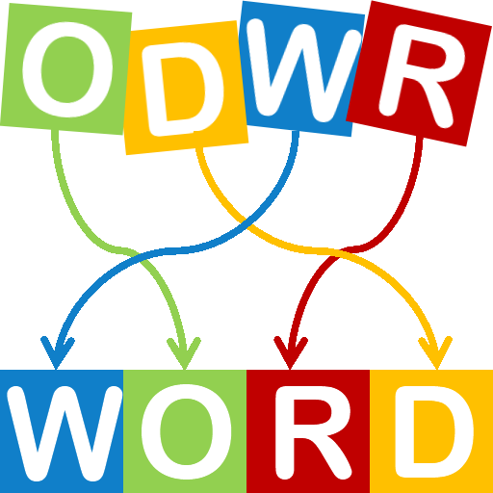

The perfect solution for generating struggling words from games.
https://github.com/ksu-is/CodedLetters
Developer: Nathan Pool
Original code attributed to peterapps.

